Slide 1
Replacement Analysis
Basic concept of defender and challenger
Economic service life
Replacement strategies under finite and infinite planning horizon

Slide 2
Meaning of replacement analysis
Replacement analysis typically refers to a decision-making process where one evaluates whether to replace an existing asset, equipment, or system with a new one based on various factors such as cost, performance, efficiency, and potential benefits. It's commonly used in business and engineering contexts to determine the optimal time to replace aging or obsolete assets to maximize value or utility.
Key steps in replacement analysis often include:
1. Identifying the Existing Asset: Clearly defining the asset or system that is being considered for replacement.
2. Establishing Evaluation Criteria: Determining the criteria against which the replacement option will be evaluated (e.g., cost, performance, reliability).
3. Cost Analysis: Assessing the costs associated with both the existing asset and the replacement option. This includes initial costs, maintenance costs, operating costs, and disposal costs.

Slide 3
4. Benefit Analysis: Evaluating the benefits expected from the replacement, such as improved performance, increased efficiency, reduced downtime, or enhanced capabilities.
5. Decision Making: Comparing the costs and benefits to determine whether replacing the asset is financially and operationally justified.
6. Risk Assessment: Considering risks associated with both options, including implementation risks, operational risks, and potential future changes in technology or requirements.
7. Sensitivity Analysis: Conducting sensitivity analysis to understand how changes in assumptions (e.g., inflation rates, discount rates) impact the decision.
8. Implementation Plan: Developing a plan for the replacement process, including timelines, resource allocation, and potential impacts on operations.
By systematically analyzing these factors, organizations can make informed decisions regarding asset replacement to optimize resources, improve efficiency, and maintain competitiveness.

Slide 4
Reasons for Replacement
There are several common reasons why replacements of assets, equipment, or systems may be necessary or beneficial:
Technological Obsolescence: Advancements in technology often render older equipment or systems inefficient, less productive, or incompatible with newer standards or requirements.
Were and tear: use of the assets, physically destroy
Increased Efficiency: Newer models or systems may offer improved efficiency, reducing operational costs such as energy consumption or maintenance requirements.

Slide 5
Enhanced Performance: Upgrading to newer versions can lead to improved performance metrics such as speed, accuracy, capacity, or reliability.
Reduced Maintenance Costs: Older assets may require frequent repairs and maintenance, which can be costly over time. Newer equipment may offer reduced maintenance needs and costs.
Regulatory Compliance: Changes in regulations or standards may necessitate the replacement of equipment to ensure compliance with updated requirements.
Safety and Environmental Concerns: Newer equipment often incorporates safety features and environmental considerations that may not be present in older models.

Slide 6
Economic Justification: Replacement decisions are often driven by cost-benefit analysis, where the long-term savings or benefits of a new asset outweigh the costs of continued use of the old one.
Capacity or Demand Changes: If demand increases or operational requirements change, replacing equipment with higher capacity or capability may be necessary to meet new demands efficiently.
End of Useful Life: Assets may reach the end of their useful life, where continued operation becomes impractical due to high failure rates, inefficiency, or inability to meet current operational demands.

Slide 7
Meaning of Defender and Challenger
in replacement analysis, "defender" and "challenger" are terms used to describe the current asset (defender) and the potential replacement option (challenger). Here’s how they are typically understood in this context:
Defender: The defender refers to the existing asset, equipment, or system that is currently in use and is being considered for replacement. It represents the status quo or the baseline against which the challenger (replacement option) is compared.

Slide 8
Challenger: The challenger is the proposed replacement option that is being evaluated against the defender. It represents a new asset, equipment, or system that could potentially replace the existing one. The challenger is assessed based on various criteria such as cost, performance, efficiency, and other relevant factors to determine whether it offers superior benefits compared to the defender.
In replacement analysis, the decision-making process involves comparing the costs and benefits of the defender (existing asset) with those of the challenger (potential replacement). Factors like initial costs, operating costs, maintenance costs, performance improvements, technological advancements, and economic benefits play crucial roles in determining whether replacing the defender with the challenger is justified.

Slide 9
Ultimately, the goal of replacement analysis is to make an informed decision that maximizes value, efficiency, and effectiveness, considering both short-term and long-term implications of the replacement.

Slide 10
Opportunity cost approach for replacement analysis
Example
Consider the choice between the defender that has a current market value Rs 5000 and challenger that can be purchased at Rs 7500 both have the service life of 3 years and have no salvage value where MARR is 12%. Suggest which one is the best defender or challenger.
Year | Defender | Challenger
0 | 5000 | 7500
1 | 1700 | 500
2 | 2000 | 1100
3 | 2000 | 1000

Slide 11
Solution
For defender
Construct the cash flow diagram
Convert all costs into PW
Then calculate Annual equivalent cost (AEC)
PW by PVIFA
Do same for challenger
Select whichever is small.

Slide 12
Economic service life
In replacement analysis, the Economic Service Life (ESL) refers to the period of time an asset should be retained in service to minimize its total equivalent annual cost (EAC) or maximize its net present value (NPV).
In all engineering economic studies up to this point, we have made the analysis with assumed useful lives for all alternatives under consideration. For any new asset (challenger), an economic life can be computed if various operation and maintenance costs are known (or can be estimated) in addition to its year-by-year salvage values. The economic life minimizes the annual equivalent cost of owning and operating an asset and it is often shorter than useful or physical life. Economic date regarding defenders and challengers are periodically updated and replacement studies are then repeated to ensure an ongoing evaluation of improvement opportunities that is the selection of challengers

Slide 13
The total annual equivalent costs of owning and operating an assets AEC (i) is the summation of the capital recovery cost and the annual equivalent of operating cost of the assets
AEC(i) = CR(i) +OC (i)-----------------------(I)
The economic service life of an asset is defined as the period of useful life that minimizes the AEC of owning and operating the asset. To get exact economic service life, we need to find the value of N years that minimizes AEC as expressed equation (I)
Economic service life is the useful life of the defender and challenger where there is least AEC.

Slide 14
Example: suppose a company has decided to have a new machine costing.18000 and useful life 8years.
And having operation cost Rs 3000 in first year and for the remaining years increase 15 percent every year. Salvage value is declined each year by 20% from the previous year's salvage value. Find the economic service life where MARR is 12%.

Slide 15
Calculation of economic service life
First of all, construct cash flow diagram showing incremental cost decrement of salvage value
Salvage of the first year is 14400
Calculate for individual years

Slide 16
First year cost = 3000 Salvage value = 14400
Convert 3000 into zero year and divide it by pvifa12%1 year
AEC(i) = CR(i) + OC (i)-----------------------(I)
CR cost = 18000/pvifa12%1 year -14400/fvifa12% 1 year = 5760
OC= 3000/1.12/ pvifa12%1 year = 3000
First years AEC= 5760+3000= 8760

Slide 17
For second year follow cash flow diagram
First years cost 3000
Second years cost 3450

Slide 18
Second years salvage value is 11520 construct cash flow diagrams
CR cost = 18000/pvifa12%2 years – 11520/fvifa12%2 years = 5217
OC= (3000/1.12) divide by pvifa12% 2 years+ (3450/1.12^2) pvifa12%2years = 1885+1627= 3212
Second years AEC= 5217+3212= 8429

Slide 19
For third year
First years cost 3000 Second years cost 3450Third years cost = 3967.5
Third years salvage value is 9216
CR cost = 18000/pvifa12%3 years – 9216/fvifa12%3 years = 4763
OC 12%= (3000/1.12) divide by pvifa12% 3 years+ (3450/1.12^2) pvifa12%3years+(3967.5/1.12^3) pvifa12%3years
= 1115+1145+1176=3436

Slide 20
AEC12% = 4760+3436=8199
Similarly if we calculate
N4 we get AEC= 8055
N5 we get AEC= 7985
N6 we get AEC= 7977
N7 we get AEC= 8024
In year six we have 7977 and it started to increased in 7 year so we don’t need to calculate the cost of N8,
Since Economic service life is the least AEC so 6 year is the economic service life . …..
Economic service life of challenger and defender
Determination of an economic life for the challenger and defender is important in a replacement analysis because of the fundamental principle that new and existing assets should be compared over their economic lives.

Slide 21
Replacement analysis when required service life is long
We understand how the economic service life of an asset is determined. The next question will be when is the optimal time to replace the defender? For it, we need to consider the following three factors or assumptions.
Planning horizon / study period
Technology
Relevant cash flow information
Planning horizon: planning horizon refers required economic service period by the defender and a sequence of future challengers. Infinite planning horizon is used when we are unable to predict the activity under consideration will be terminates. When the project will have a definite and predictable duration, the replacement policy should b e formulated more realistically on the basis of a finite panning horizon.

Slide 22
Technology: it refers to the development of types of challengers they may replace under study. If we assume that all future machines will be the same as those now in use, we are saying that no technological process will occur. In other cases, we may express the possibility of machine becoming in future more efficient, reliable or productive than those are available in the market currently, which leads to the recognition of technological changes and obsolescence. If the available machine gets better and better over time, we should investigate the possibility of delaying assets replacement for a couple of years.

Slide 23
Relevant cash follows over the life an asset: many predictions can be used to estimate the patters of revenue, cost and salvage value over the life of an asset. We will focus whether preplacement analysis is directed towards cost minimization or profit maximization. We formulate a replacement policy for an asset whose salvage value does not increase with age.

Slide 24
Decision framework
Decision framework is developed by indicating a replacement sequence of assets with the nation (jo, no) ( j1, n1) (j2,n2)-------(jk, nk). Each pair of numbers (j,n) indicates a type of asset and lifetime over which that asset will be retained. For example, defender asset (jo) replaced now (no=0) can be written as (jo,0)
The sequence (jo,2) (j1,5) (j2,3) indicates retaining the defender for two years and the n replacing defender with an asset type of j1 and using it for five years and then replacing j1, with an asset of type j2 and using it for three years. Hence, the total planning horizon covers 10 years (2+5+3)

Slide 25
Finite planning horizon of 10 year (jo,2) ( j1,5) (j2,3)
Although the economic life of the defender is defined as the additional number of years of service which minimizes the annual equivalent cost (AEC), that is not necessarily the optimal time to replace the defender. The correct replacement time depends on data on the challenger as well as data on the defender.
AEC method provides a direct solution when the planning horizon is infinite and when the planning horizon is finite, the PW method is more convenient to use.

Slide 26
Replacement analysis under the infinite planning horizon
Under the infinite planning horizon, the service is required for a very long time either we continue to use the defender to provide the service or we replace the defender with best available challenger for the same service. In this case, we may apply the following procedure in replacement analysis.
Step one: compute the economic lives of both the defender and challenger. Let ND and NC is used to indicate the economic lives of the defender and challenger and the annual equivalent costs AEC for the defender and challenger at their respective economic lies are indicated by AECD and AECC

Slide 27
Step two: compare AECD and AECC
If AECD is greater than AECC, it is the situation of more costly to keep the defender than replace it with challenger. Hence challenger should; replace with defender now.
If AECD is less than AECC, it costs less to keep the defender than to replace it with the challenger. hence, defender should not be replaced now.
Step three
If defender should not be replaced now, when should it be replaced?

Slide 28
First, we need to continue to use it until its economic life is over.
- Then we should calculate the cost of running the defender for one more year after its economic life, this approach is called marginal analysis, ie, we calculate the incremental cost of operating the defender for just one more year.
- In another words, we want to see whether the cost of extending the use of the defender for an additional year exceeds the savings resulting from delaying the purchase of the challenger.
In this case,
- If the marginal cost of defender is greater than AECC, the defender should be replaced at the end of its economic life. Otherwise, we should calculate the cost of running the defender for the second year ie marginal cost for second year after its economic life.
- If the marginal cost of defender for the second year is greater than AECC the defender should be replaced one year after its economic life. The process should be continued until we find the optimal replacement time. here, we have assumed that the best available challenger does not change.

Slide 29
Example: an electrical company is considering replacing the old machine with newer one for it.
Option one
If repaired the old machine that can be used for another 6 years. That will require Rs 1200 to overhaul repair. The operating cost is estimated RS2000 for first year and expected to increase Rs1500 per year thereafter. However, the company can sale it now for Rs 5000 and further market values are expected to decline by 25% each year over the previous year's value.
Option two
The new machine cost is 10000 and will have operating cost of Rs 2200 in the first year and expected to increase by 20% per year thereafter. The expected salvage value is Rs 6000 after one year and will decline by 15% each year for 8 years.
Find the economic life for each option and determine when the defender should be replaced at MARR is 15%?

Slide 30
Solution
Calculation of Economic service life for defender
The opportunity cost of the machine is Rs 5000. Because overhauling cost of Rs 1200 is also needed to machine operation, the total initial cost of machine is Rs 5000+Rs 1200 = Rs 6200
We can calculate the annual equivalent cost AEC if the defender is to be kept for one year, two years, three years and so forth with the following equation and diagram.
For first year
AEC15% 1 year
CR cost = 6200/ pvifa15%1 year – 3750 fvifa15%1 year = 7130-3750=3380
OC cost = 2000/1.15 whole divide by pvifa 15% 1 year = 2000
AEC15% = 3380+2000= 5380

Slide 31
For second year
AEC15% 2 year
CR cost 15% 2 year = 6200/ pvifa15% 2 years – 2812 / fvifa 15% 2 years = 2506
OC 15% 2 year = 2000/1.15 whole divided by pvifa15%2 years + 3500/1.15^2 whole divided by Pvifa15% 2 years =2697
AEC15% =2506+2697= 5203

Slide 32
For third year
By following above process we get AEC for third year is 5468
The AEC in third year is greater than second year, so the economic service life for defender is 2 year with AECD = 5203
Calculation of economic service life of challenger
The economic life of challenger can be determined with the following cash flow schedule and MARR=15%

Slide 33
Construct the cash flow diagram for challenger
AEC for first year
CR cost = 10000/ pvifa15%1 year – 6000 fvifa15%1 year = 11500-6000=5500
OC cost = 2200/1.15 whole divide by pvifa 15% 1 year = 2200
AEC15% = 5500+2200= 7700

Slide 34
AEC for second year
CR cost 15% 2 year = 10000/ pvifa15% 2 years – 5100 / fvifa 15% 2 years = 3779
OC 15% 2 year = 2200/1.15 whole divided by pvifa15%2 years + 2640/1.15^2 whole divided by Pvifa15% 2 years =2405
AEC15% =3779+2405= 6184

Slide 35
By following same procedure as above
We get
At 3rd year 5756
At 4th year 5625
At 5th year 5631

Slide 36
Since it started to increase the cost from 5th year, we don’t have to calculate the further.
From the above calculation, the economics life of the challenger is 4 years with AEC= 5625
Since AEC of defender =5203 is less than AEC of challenger = 5625, the defender should not be replaced for now. If there are no technological advances in the few years, the defender should be used for at least 2 more years. It depends on what type of challenger would be available in the future.

Slide 37
When should the defender be replaced?
If we need to find the answer to this question at present, we have to calculate the cost of keeping and using the defender for the third year from toady. For this
- Opportunity cost at the end of year = market or salvage value of defender at the end of year 2 = 2813
- Operation cost for the third year = 2000+1500+1500= 5000
- Salvage value at the end of third year 2109

Slide 38
Hence, the cost of using the defender for one more year from the end of its economic life is
2813x1.15+5000-2109= 6126 which is greater than 5625 ie AECC .
Since AECC = 5625, it is more expensive to keep the defender for the third year than to replace it with the challenger.
Accordingly, we conclude that we should replace the defender at the end of year 2. If the third-year cost of defender is still smaller than AECC we need to calculate the cost of using defender foe the fourth year and then compare it with the AECC of the challenger

Slide 39
Replacement analysis under the finite planning horizon
If the planning period is finite ie fixed and specified, a comparison with AEC method over the economic service life does not generally apply. In such cases there is to establish all reasonable replacement patterns and then use PW value for the planning period to select the most economical pattern

Slide 40
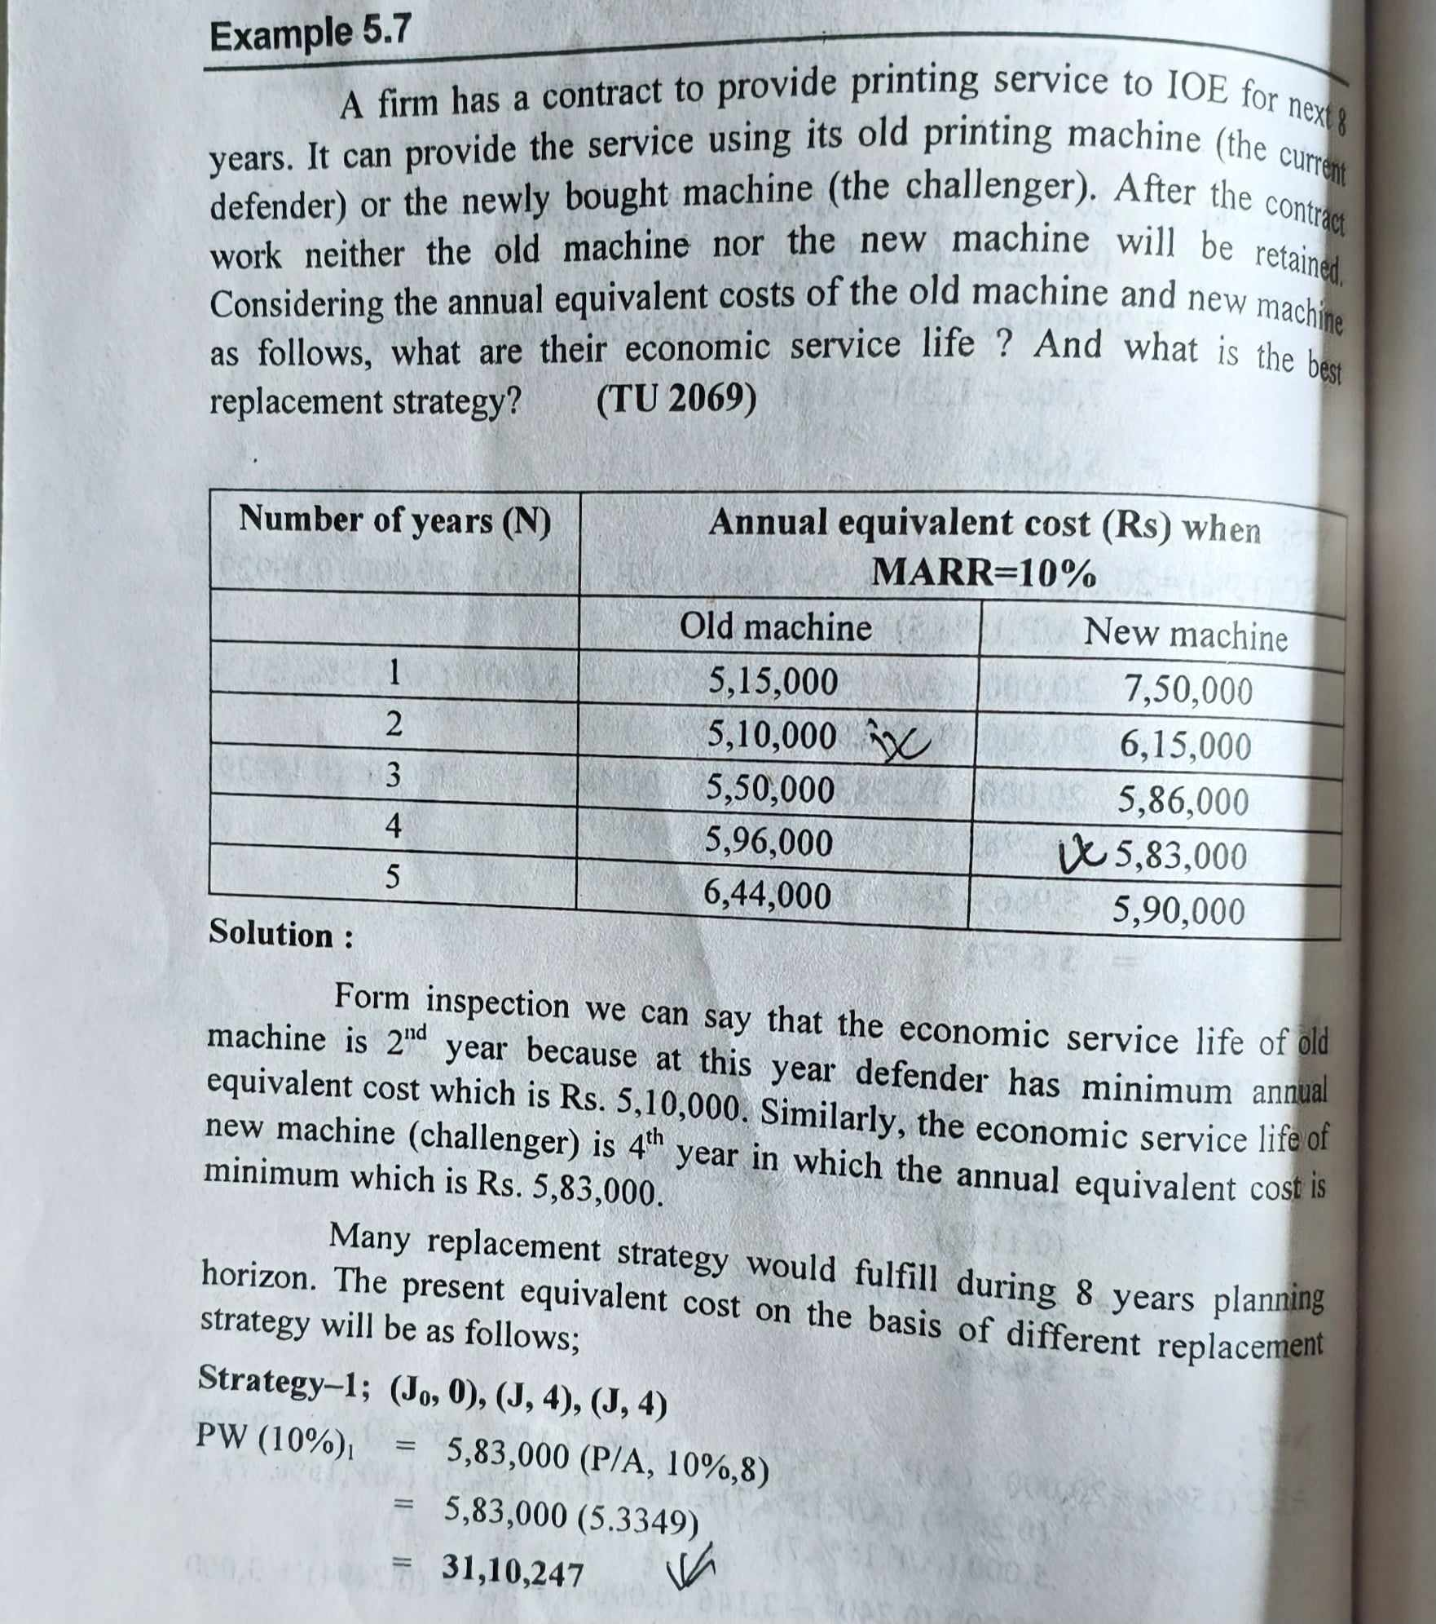

Slide 41
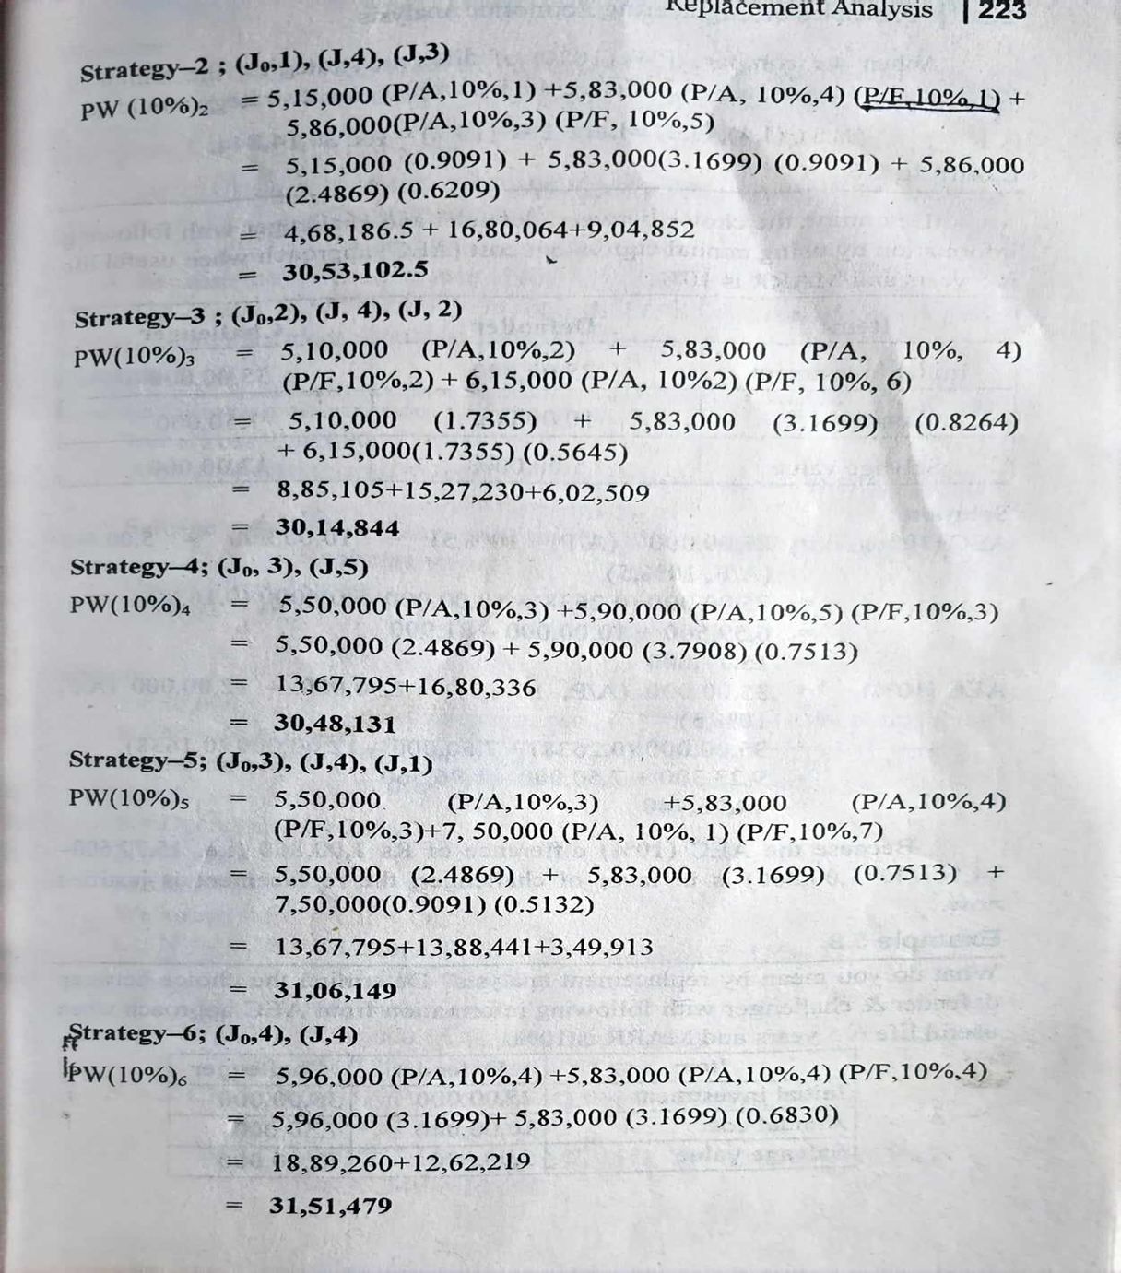

Slide 42
When we compare PW(10%) of different strategies, the minimum PW is derived by strategy -3. Hence, the best replacement strategy would be (j0,2), (j,4),(j,2) where PW(10%)= Rs 3014844

Slide 43
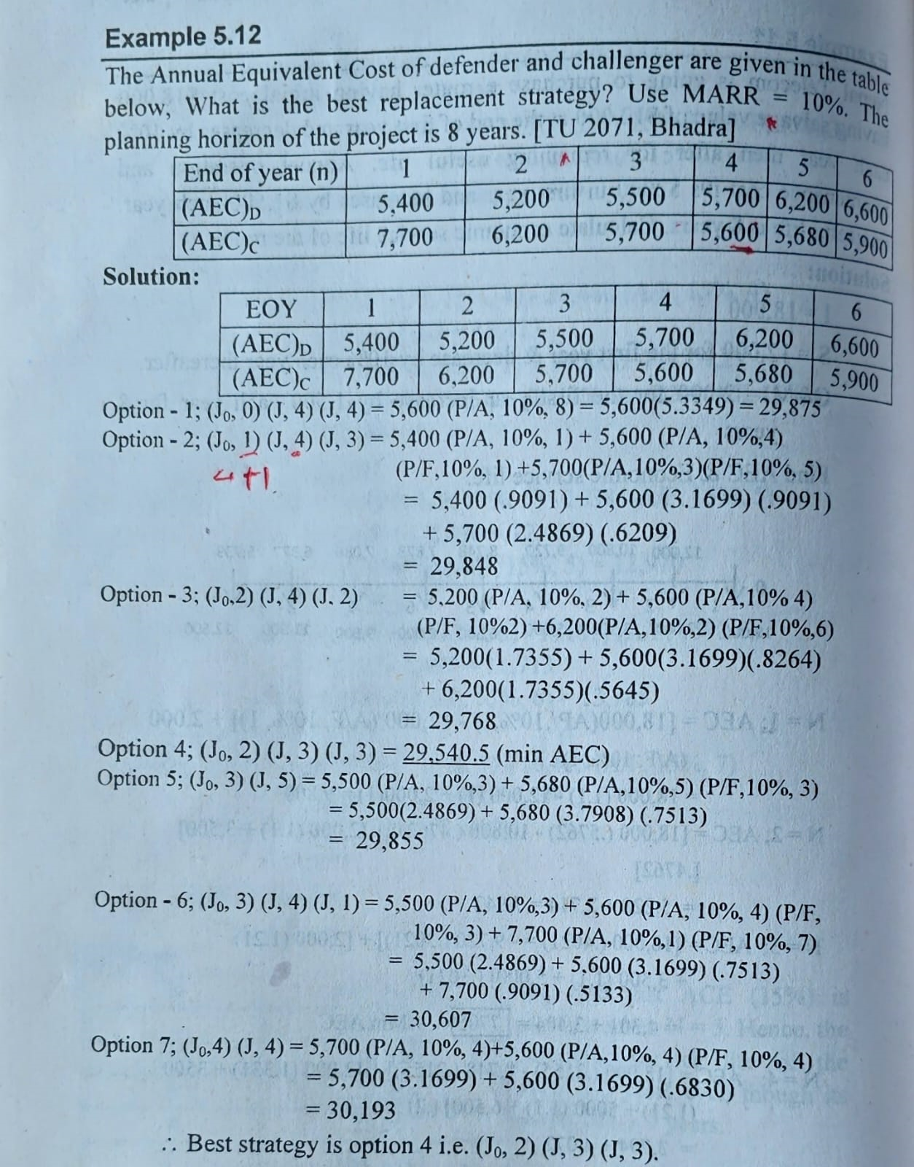

Slide 44
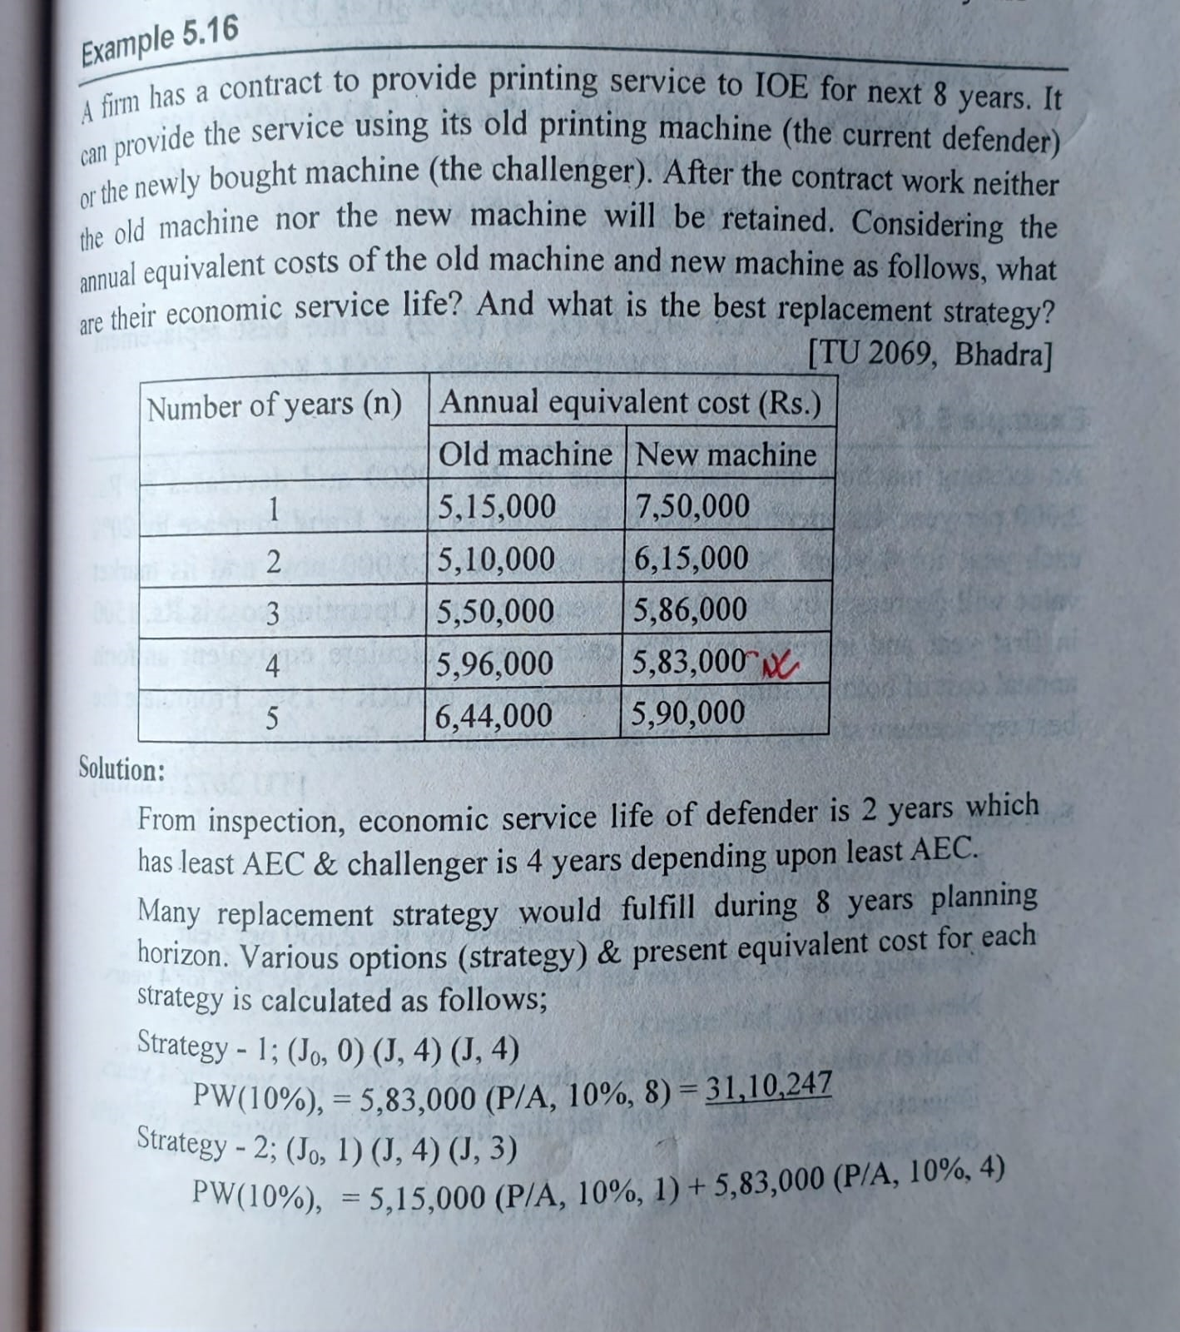

Slide 45
